Slide 1
Software Engineering Processes
Assignment 1 - Testing (resit)
Mihnea Ciocioiu

Slide 2
Introduction
Project chosen: Requests library
Project URL: https://github.com/psf/requests
Fork URL: https://github.com/MihneaCiocioiu/request
For this project I chose to improve the existing coverage by adding coverage support for the following functions:
Remove_cookie_by_name()
_find()

Slide 3
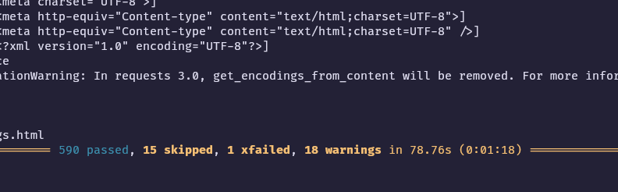
Initial coverage report
I have attached a screenshot of the initial coverage report, from where you can notice that initially 590 tests are passing.
Command used: coverage run -m pytest

Slide 4
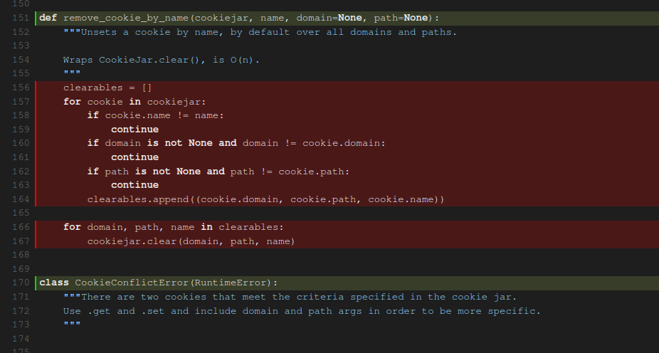
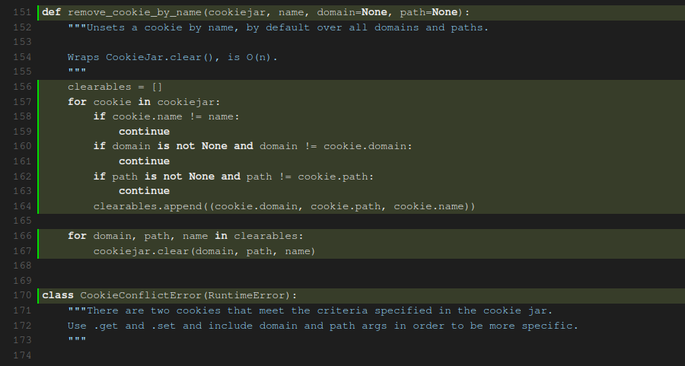
remove_cookie_by_name()
Before and after of the coverage of the function remove_cookie_by_name that is shown in the report generated by the command coverage html

Slide 5
Tests used for the coverage
I have created a new file called test_new.py where I wrote the tests for the new functions.
List of functions used:
test_remove_cookie_by_name()
test_remove_cookie_by_name_no_match()
test_remove_cookie_by_name_specific_domain()
test_remove_cookie_by_name_specific_path()
test_remove_cookie_by_name_path_mismatch()
All of these functions are helping to reach full branch coverage of our function.

Slide 6
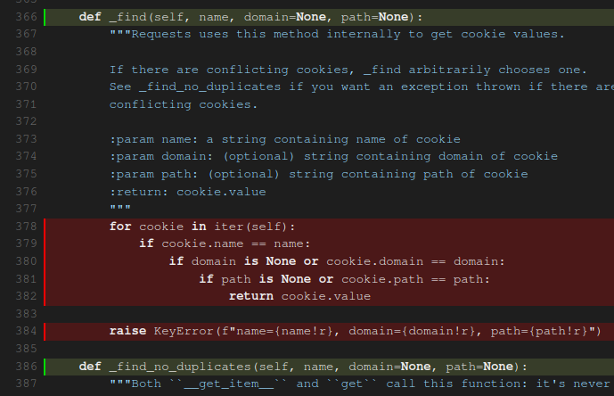
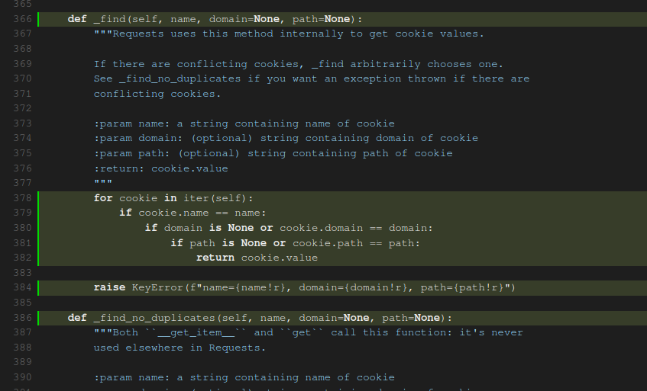
_find()
Before and after of the coverage of the function _find() using the same report

Slide 7
Tests used for the coverage
In the same test_new.py file, the following functions are used to test the function _find():
test_find_cookie_by_name()
test_find_cookie_by_name_and_domain()
test_find_cookie_by_name_domain_and_path()
test_find_cookie_not_found()
All of these functions are helping to reach full branch coverage of our function.

Slide 8
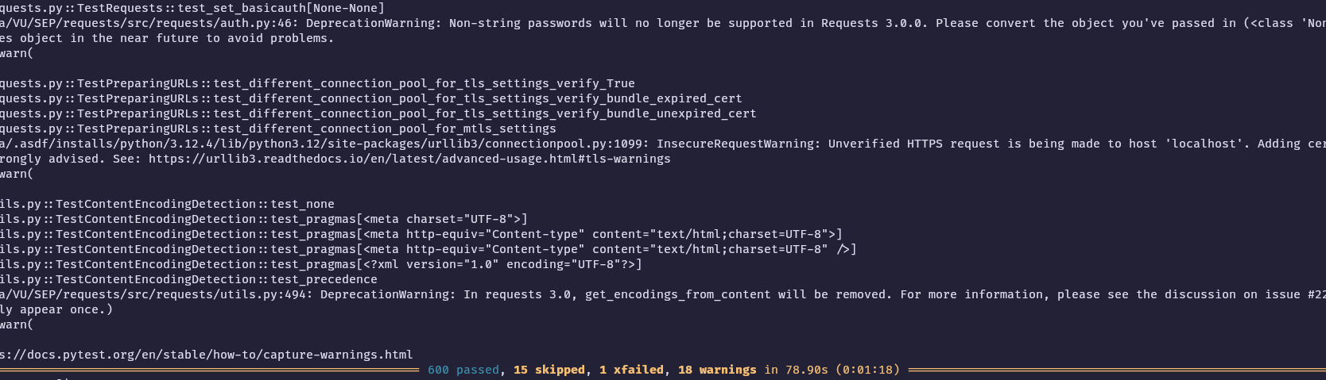
Final coverage report
After adding the improvements, here is the final coverage report output, from which an improvement is seen, the code reaching 600 passed tests from the initial 590

